Slide 1
Individual Meeting
Jason Chang

Slide 2
Outline
TSMC
demand_forecasting
GoEdge.ai
Reservoir Data Analyst
Own Paper
TimeDRL (accepted by ICDE 2024)
LLM4TS (submitted to TIST 2024)
Future Papers
PromptTSS (target: AAAI 2025)
TimeDRL-semi (target: TKDD or TNNLS)

Slide 3
Before we start
TSMC合作
去美國前的合作
Demand forecasting (競爭者分析)
並非只是暑期實習，暫定實習到出國前 (2025/02)
目前只到9/30，10/01要等之後繼續簽約
去美國後的合作
與在台灣的合作是否有直接關聯? (同樣的部門嗎?)
UCLA交換
目前已經取得兩邊老師的同意以及對方老師的推薦函
需要申請Visiting Graduate Researchers (VGRs)
千里馬申請
目前只剩下計畫書
沒有申請到，還是可以出國嗎? (我認為應該是，就只是沒有獎學金而已)
可以試試看華仁全球講座

Slide 4
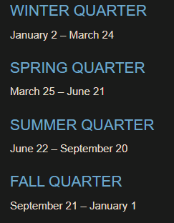
Current Schedule
目前~2024/08：PromptTSS
2024/06~2025/02：TSMC intern (1 conference paper) + Journal paper for TimeDRL
2025/02~2026/02：UCLA + TSMC collaboration in US
Winter (partial) + Spring + Summer + Fall + Winter (partial)
2026/03：口試+畢業
2026/04：TSMC US (綠卡) or other companies
2025 Chinese New Year: 2025/01/28 ~ 2025/02/02
2026 Chinese New Year: 2026/02/16 ~ 2026/02/20
UCLA Exchange: 2025/02/10 ~ 2026/02/10

Slide 5
UCLA VGRs – Prior to Arrival at UCLA
An administrator from the faculty member’s department will initiate the application.
Once the department submits the information, both the faculty sponsor and the chair of the department need to approve your application. Then you will receive an email inviting you to apply online for a Visiting Graduate Researcher appointment.
The department reviews your application before sending it to the Graduate Division for temporary approval. You will receive an email when you have been approved temporarily by the Graduate Division.
請Wei Wang幫忙申請”VGR申請資格”
VGR申請資格認可，
開始申請VGR
成功申請VGR

Slide 6
UCLA VGRs – Upon Temporary Approval
The Graduate Division will provide an electronic, final approval of the completed application to you and your department.
You will need a UCLA BruinCard for access to University privileges and facilities, please work with your sponsoring department to obtain a BruinCard.
Sign the Oath and Patent Acknowledgement Form. Your department administrator will have the form for you to read and sign. It will be retained in your records with the sponsoring department.
For International Visitors:
Work with your sponsoring department to obtain a DS-2019 Certificate of Eligibility Form. Use the DS-2019 to apply for the J-1 visa stamp at your nearest U.S. Embassy.
Purchase health insurance or apply for a waiver.
拿到VGR證明
拿到UCLA學生身分 (申請宿舍，但機率很小)
簽署宣誓和專利確認表
申請DS-2019，之後拿來申請J1 Visa
健保

Slide 7
UCLA VGRs
感覺可以先開始跑?
需要知道確切的交換日期
請Wei Wang幫忙申請”VGR申請資格”
Prior to Arrival at UCLA
VGR申請資格認可，開始申請VGR
成功申請VGR
拿到VGR證明
拿到UCLA學生身分 (申請宿舍，但機率很小)
Upon Temporary Approval
簽署宣誓和專利確認表
申請DS-2019，之後拿來申請J1 Visa
健保
拿到千里馬獎學金 (11/30)

Slide 8
千里馬計劃書

Slide 9
TSMC

Slide 10
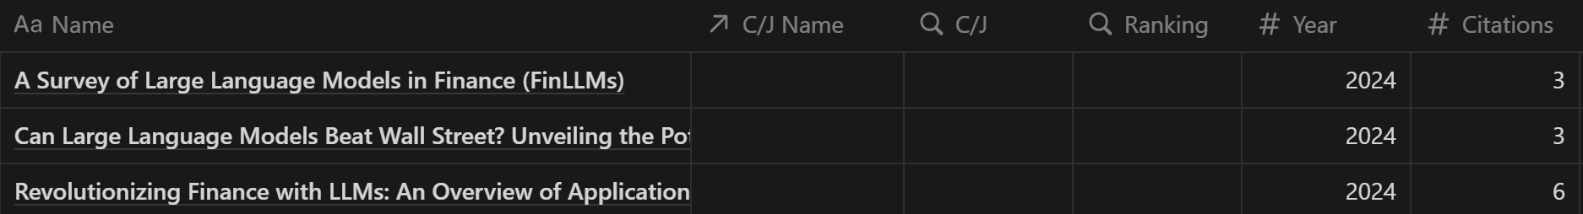
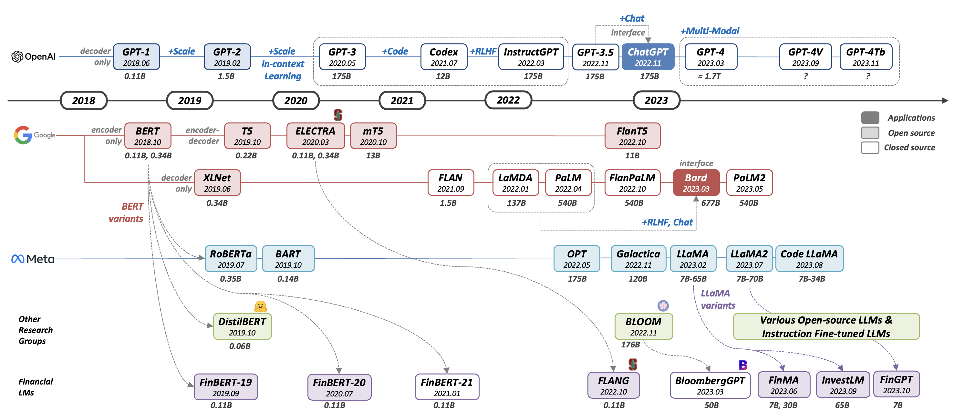
Paper List

Slide 11
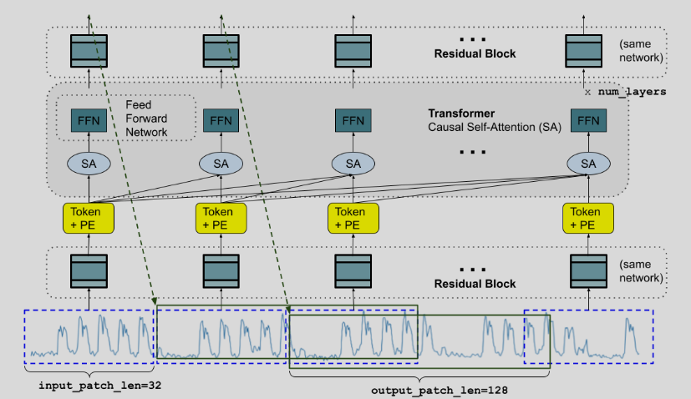
TimesFM (from Google, ICML 2024)
TimesFM is a forecasting model, pre-trained on a large time-series corpus of 100 billion real world time-points, that displays impressive zero-shot performance on a variety of public benchmarks from different domains and granularities.

Slide 12
GoEdge.ai

Slide 13
Own Paper

Slide 14
Publication Lists (First Author)
TimeDRL (ICDE 2024 accepted)
LLM4TS (TIST 2024 submitted)
PromptTSS (target: ICDM 2024)
TimeDRL-semi (only 25% difference)
Q1 journal (after ICDE acceptance)
TIST, TNNLS, TKDD, TPAMI
After the third paper
TSMC paper
UCLA paper

Slide 15
PromptTSS
Ching Chang

Slide 16
Why promptable?
Leverage more information in the inference stage
Mult-level granularity

Slide 17
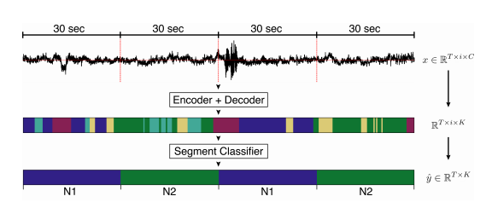
Multiple Granularity of Time-Series Segmentation
Prompt:
Class
Point
Level 1
Level 2
Level 2
Promptable
Design
Level 2
Requirements:
When training, we can leverage multi-granularity labels
When inference, we can give no prompts
Level 1
input
output

Slide 18
Experiments
Datasets
Evaluation Metrics
Baselines

Slide 19
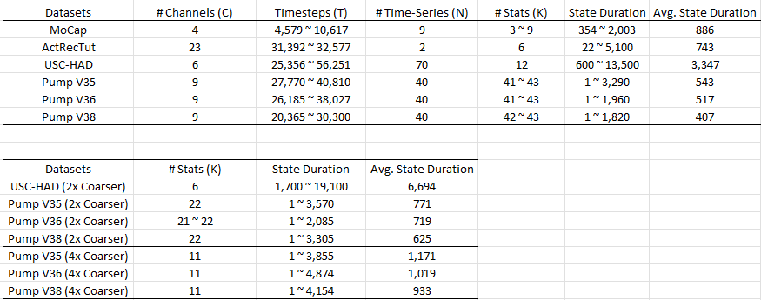
Datasets

Slide 20
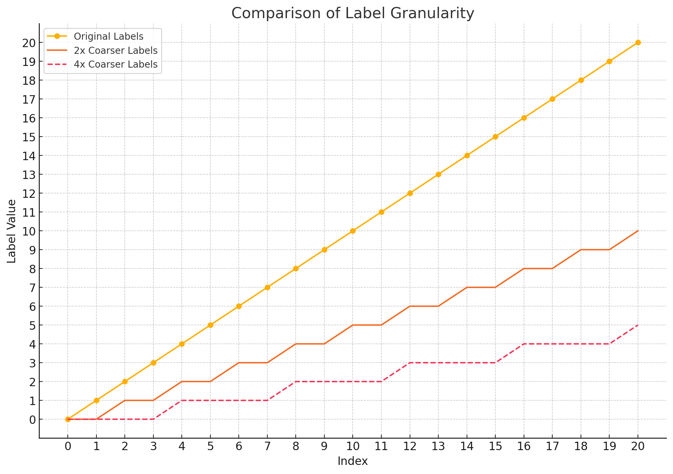
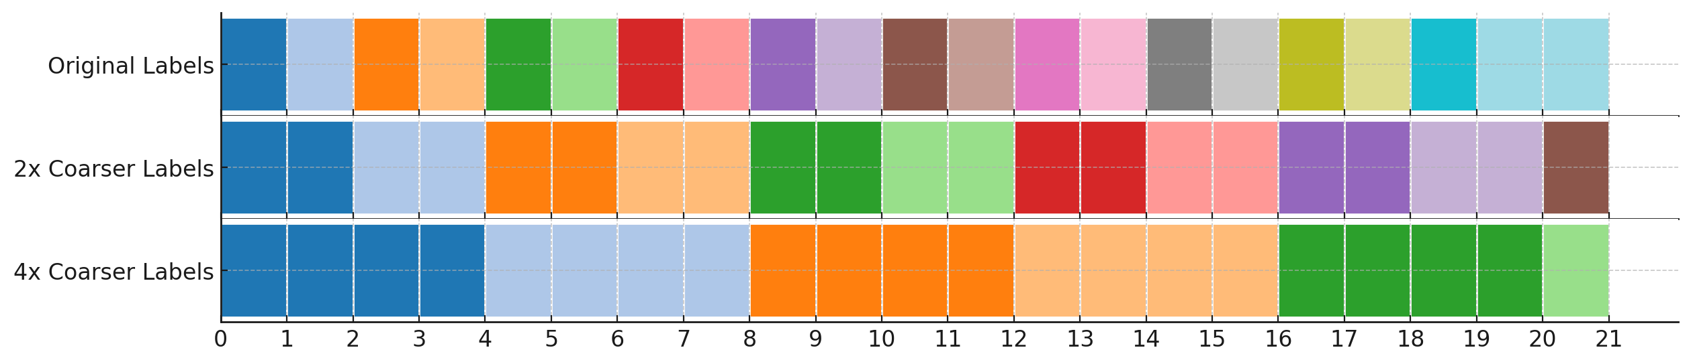
Multiple Granularity
How to change from high granularity to low granularity: merge!

Slide 21
Input and Output
Time-Series
Granularity
Information
Labels

Slide 22
Evaluation Metrics
Segmentation (often used in supervised)
Accuracy
MF1 (Macro F1)
Kappa
Clustering (often used in unsupervised)
ARI
NMI

Slide 23
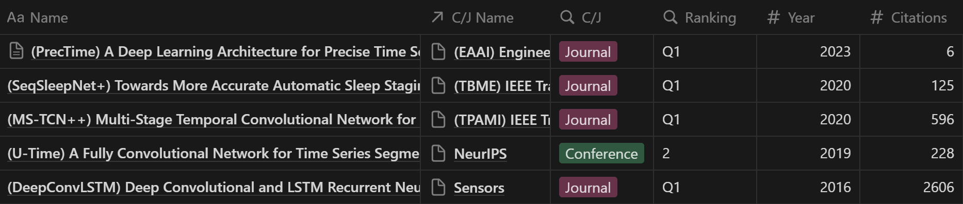
Baselines
Supervised

Slide 24
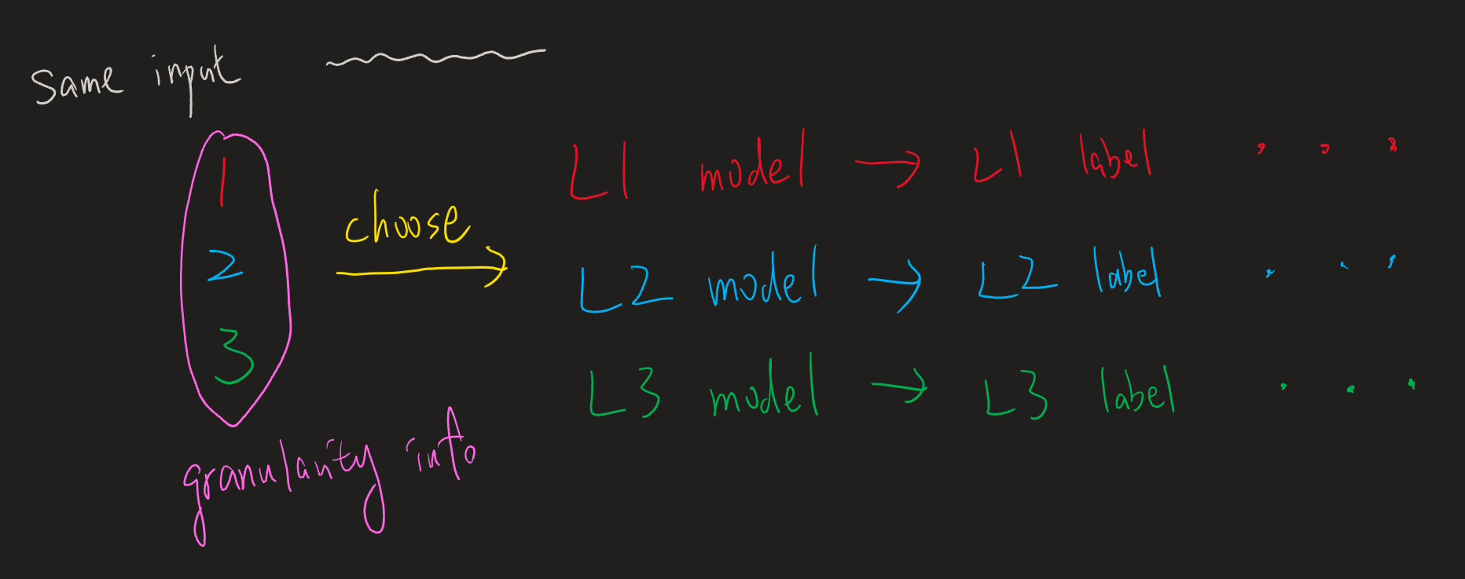
How to make baselines support multiple-granularity?

Slide 25
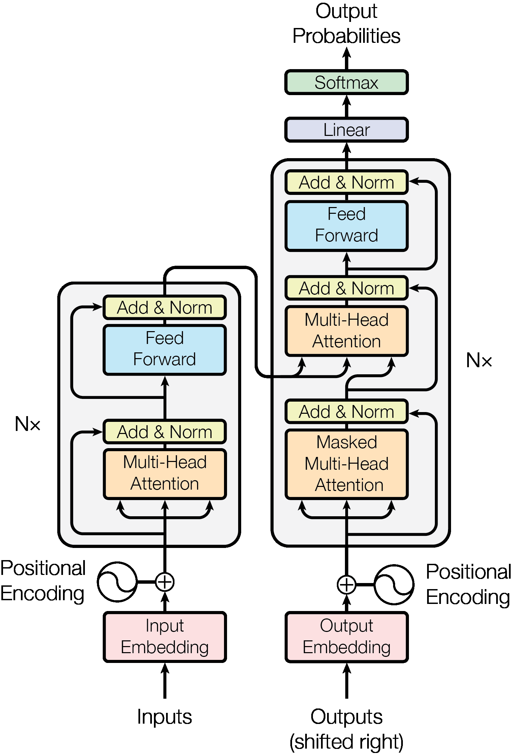
SAM v.s. PromptTSS
Segmentation
GPU
CPU
Final Mask
Image encoder
Mask decoder
Embedding
Prompt encoder
Multi-Head
Attention
Image
Prompt
Time-Series Input Layer
Prompt
Input Layer
Time-Series
Prompts

Slide 26
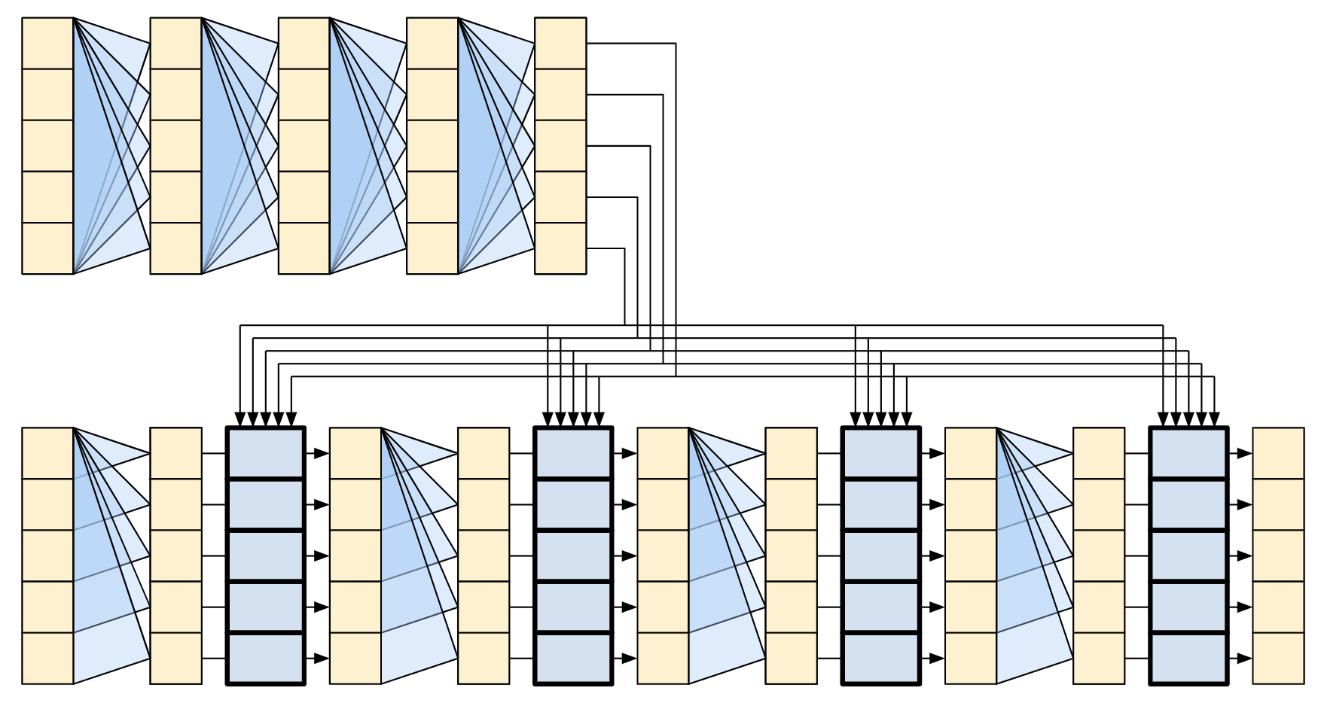
PromptTSS (w/o Patching)
Transformer
Encoder
Time-Series
(B, T_{in} , C)
(B, T_{in} , C)
(B, T_{in}, D)
(B, T_{in}, D)
Instance Normalization
(w/o affine)
Time-Series
Input Layer
(B, T_{in} )
(B, T_{in} , D)
Prompt
nn.Embedding(K, D)
Prompt
Input Layer
Transformer
Decoder
(B, T_{in} , D)
Output Layer
1. Dropout
2. Linear (B, T_{in}, K)
(B, T_{in}, K)

Slide 27
PromptTSS (w/ Patching)
Transformer
Encoder
Time-Series
(B, T_{in} , C)
(B, T_{in} , C_{t})
(B, T_{p}, C_{t}*P)
(B, T_{p}, D)
(B, T_{p}, D)
Instance Normalization
(w/o affine)
Patching
Time-Series
Input Layer
(B, T_{in} )
(B, T_{in} , C_{p})
(B, T_{p} , C_{p}*P)
(B, T_{p} , D)
Prompt
nn.Embedding(K, C_{p})
Patching
Prompt
Input Layer
Transformer
Decoder
(B, T_{p} , D)
Output Layer
1. Rearrange (B, T_{p}*D)
2. Dropout
3. Linear (B, T_{in}*K)
4. Rearrange (B, T_{in}, K)
(B, T_{in}, K)

Slide 28
PromptTSS (w/ Patching)
Transformer
Encoder
Time-Series
(B, T_{in} , C)
(B, T_{in} , C_{t})
(B, T_{p}, C_{t}*P)
(B, T_{p}, D)
(B, T_{p}, D)
Instance Normalization
(w/o affine)
Patching
Time-Series
Input Layer
Granularity level embedding
(B, T_{in} )
(B, T_{in} , C_{p})
(B, T_{p} , C_{p}*P)
(B, T_{p} , D)
Prompt
nn.Embedding(K, C_{p})
Patching
Prompt
Input Layer
Predicted
labels
Transformer
Decoder
(B, T_{p} , D)
Output Layer
1. Rearrange (B, T_{p}*D)
2. Dropout
3. Linear (B, T_{in}*K)
4. Rearrange (B, T_{in}, K)
(B, T_{in}, K)

Slide 29
Experiments
Please see the csv file

Slide 30
Thanks for your attention

